Slide 1
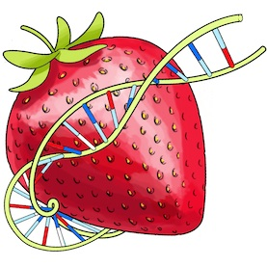
Data Visualization
Final Project – BerryVis

Slide 2
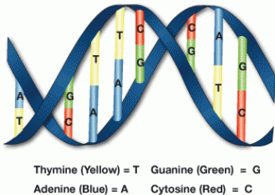
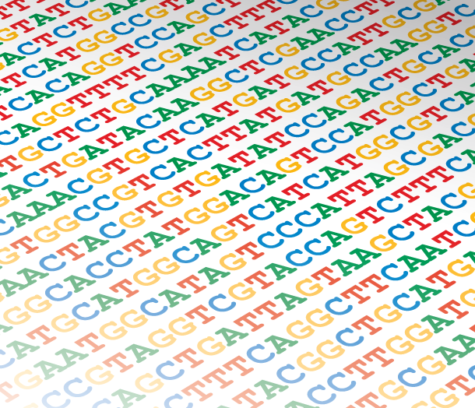
Visualizing similarities in DNA samples

Slide 3
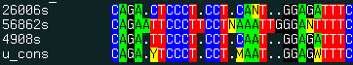
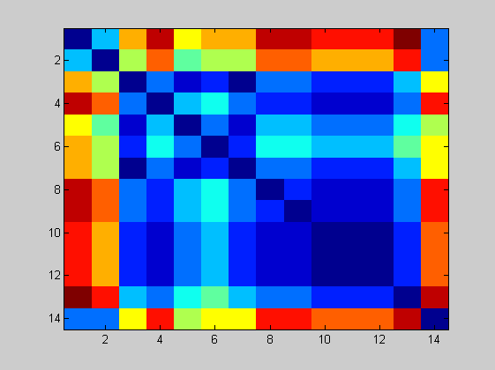
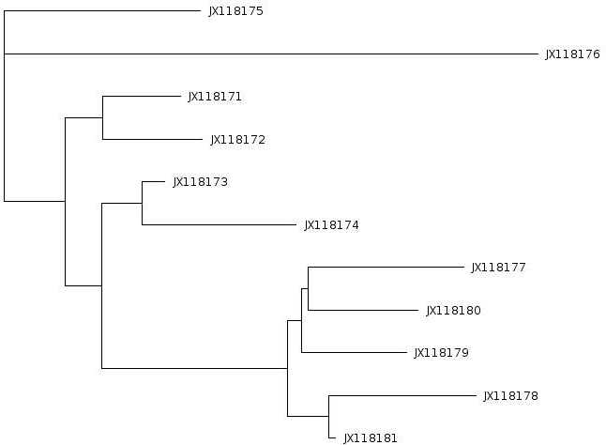
DNA sequences – finding similarities between samples
http://www.molsoft.com/man/icm-commands.html
Distance matrix
Tree view
http://www.computational-genomics.net/case_studies/sars_demo_02.png

Slide 4
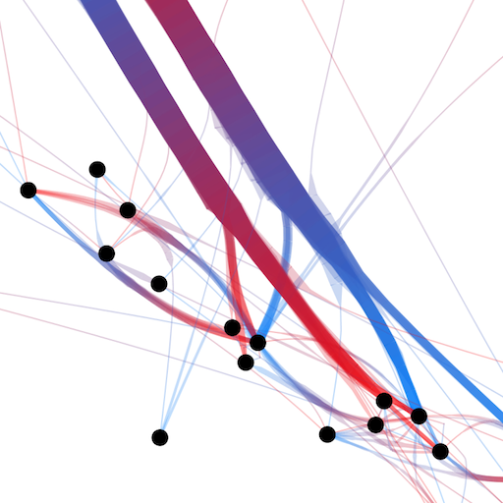
Means of visualizing the data
Classic visualization
Node-link view with colored dimension for representing distance
http://www.selassid.net/DividedEdgeBundling/bay.png

Slide 5
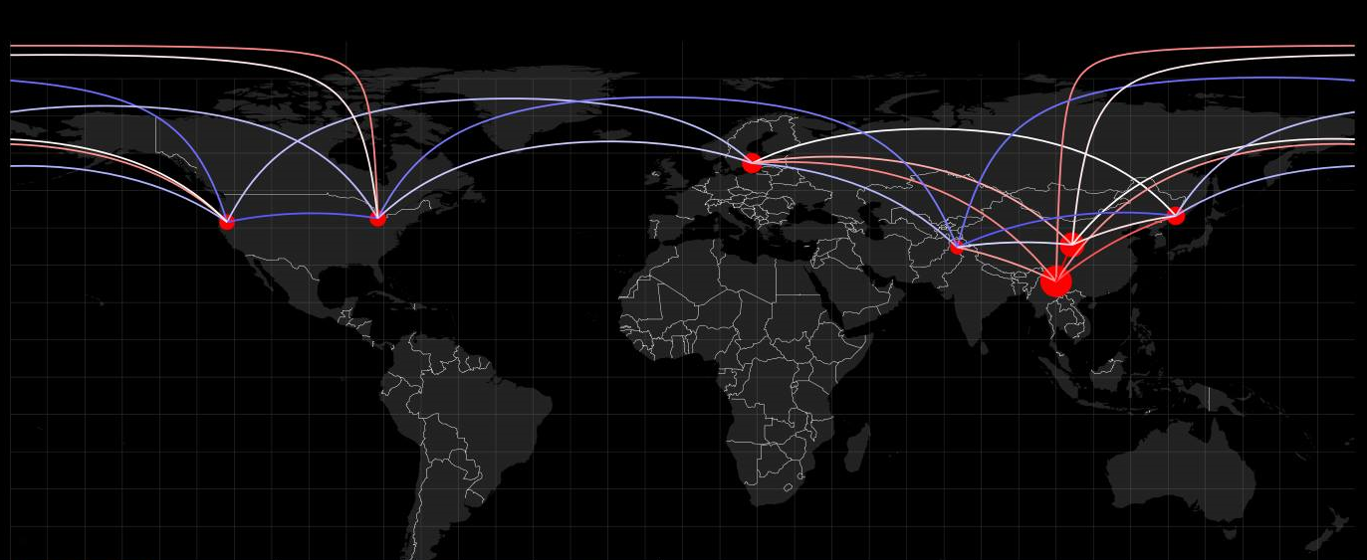


Adding more information – geographical location
Blue-white-red color range for representing genetic distance
Circle radius - hub weight (similarity of a sample to all others)

Slide 6
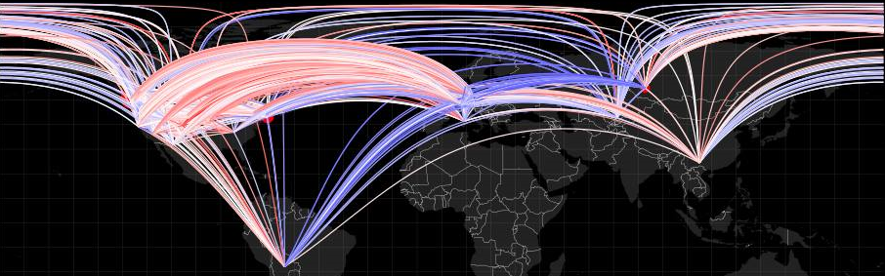
Cluttering problems
7 samples – 21 edges
270 samples – 36585 edges
Hard to distinguish and extract information.
Notes:
The first visualization works nicely and we can distinguish the fact that China is very tied to all samples around the globe. However, when we applied the same algorithm on the entire provided database (270 samples), we had difficulty in seeing any patterns or strong connections. The graph is too cluttered and the computing time considerable (grows quadratically with sample count)

Slide 7
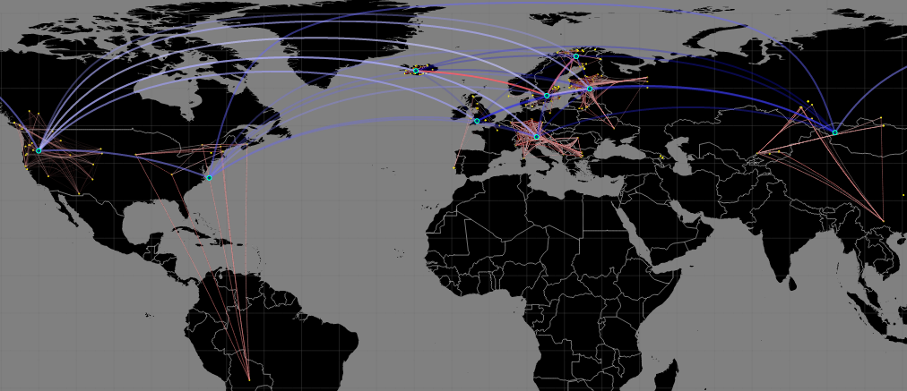
Solution Hybrid view with clustering for a hierarchical representation
Notes:
So, what we did:
-we separated the data on different regions.
-connected dots within the same region (red-to-white color range).
-created centroids (meaning center for every cluster)
-connected centroids to show inter-cluster distance (e.g. to see whether the West American Coast has similarities with Europe or China etc.)
-added transparency for less relevant connections to further reduce cluttering.

Slide 8
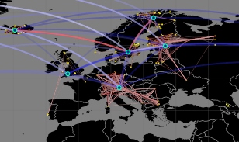
Hybrid clustering technique – hierarchical information
K-means clustering
Automatic clustering and centroid creation.
Recomputed distance matrices.
Results – Easier to perceive information in the data.
Notes:
Our hybrid technique uses:
-K-means clustering automatically grouping the samples.
-Force-edge bundling (curved arcs in the figure) for reducing the cluttering.
Everything is done automatically, the only thing needed is to input the data (the distance matrix and geographical positions) and select the cluster granularity (how many clusters do we want?)
This technique gives us a better view of the information and we can really see the strong connections between species of berries in Iceland and Finland.
We think of it as a nice approach in overviewing this kind of data and a good means for reducing the workload for specialized research.

Slide 9
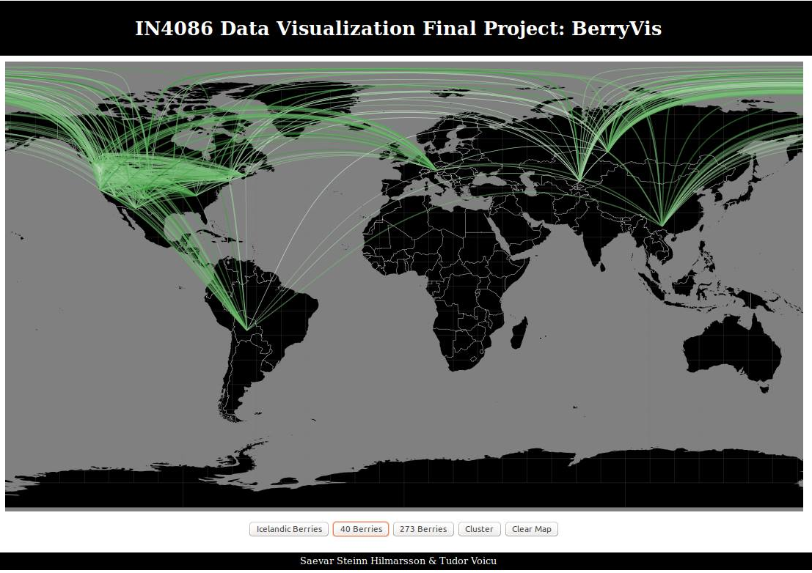
Notes:
Our demo website consists of steps and different views of visualizing our information. It has been designed in D3. For now the color ranges and the visualization settings are fixed, but the script can be extended into a functional online platform if needed for open use (we didn’t publish it anywhere).

Slide 10
Thank you!
Group 31
Saevar Steinn & Tudor Voicu

